Slide 1

Dataset of Drone Encounters
Final Project Presentation
Date: 17.06.2021
Team members: Jonathan Lahat, Alon Karmona, Roy Yogev
Academic supervision: Dr. Jessica
Cauchard

Slide 2

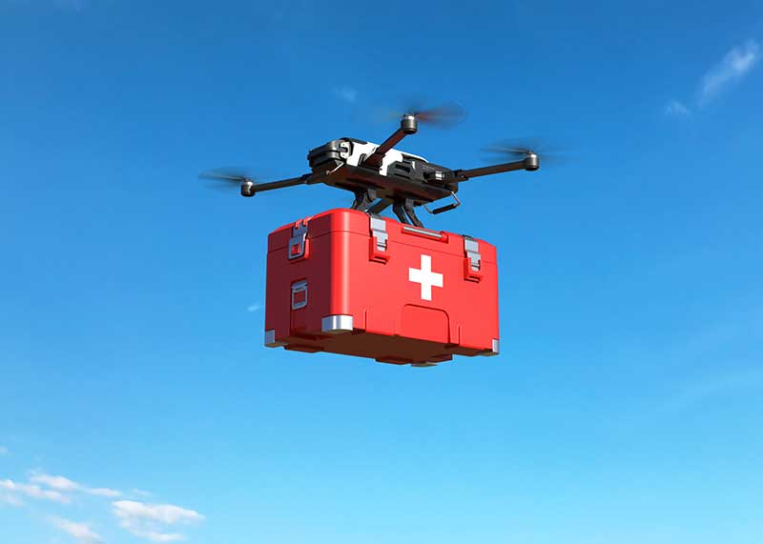

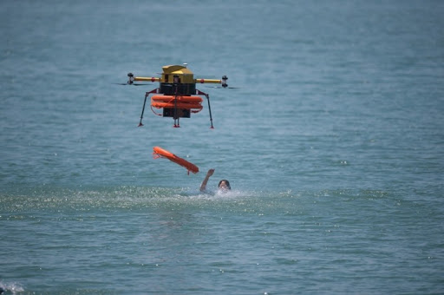
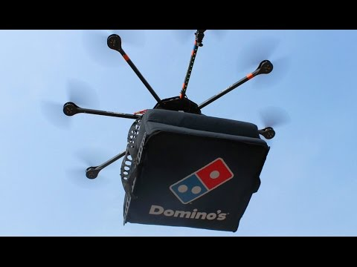
Human-Drones Interaction
Expansion in Drones’ use
Presence in populated areas
Relatively limited research

Slide 3
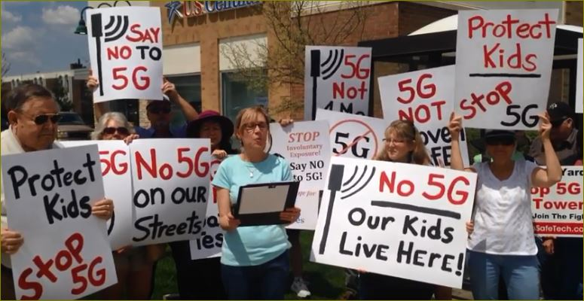
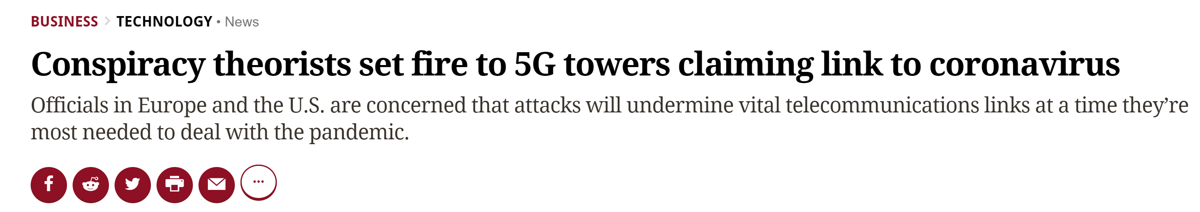
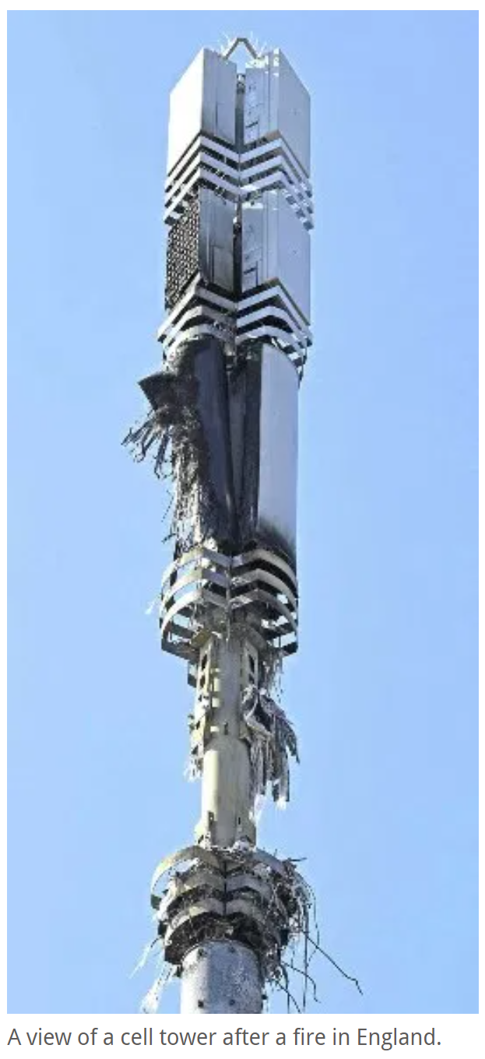

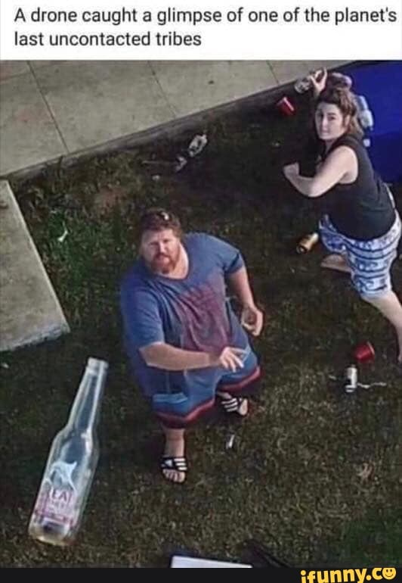
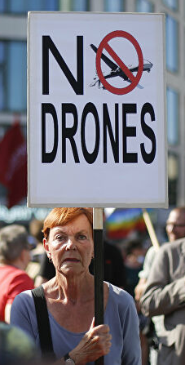
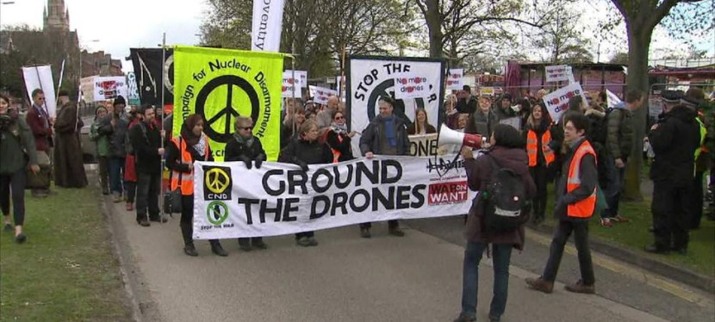
Motivation

Slide 4
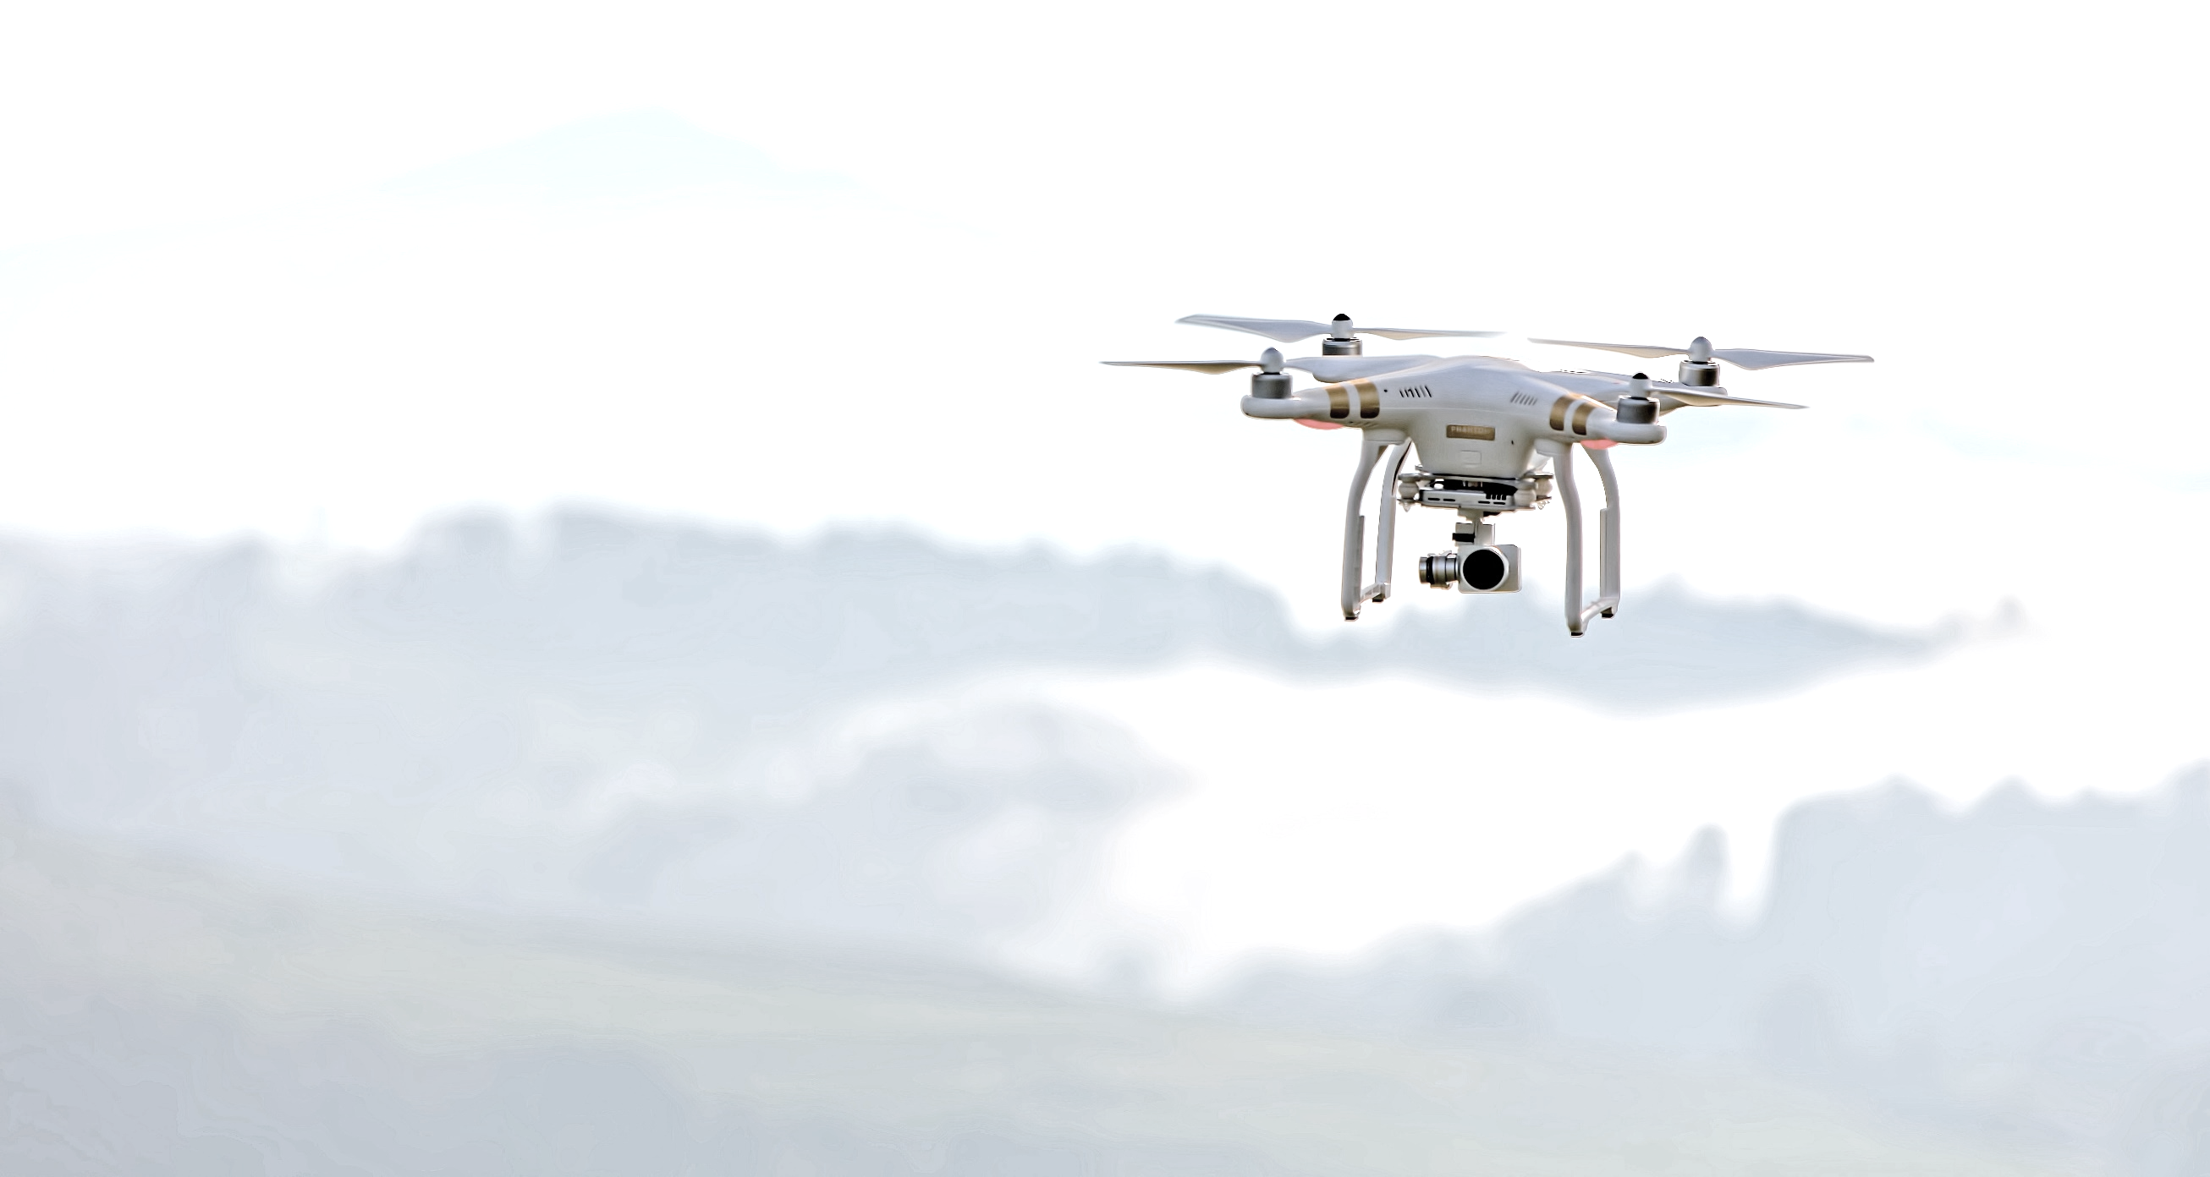



Our Goal
DATASET CREATION

Slide 5

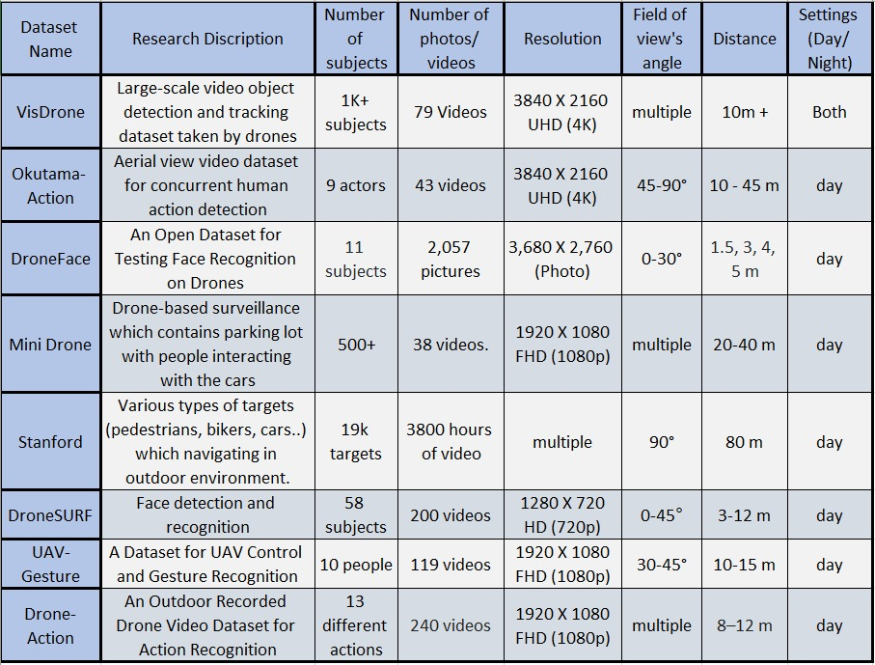
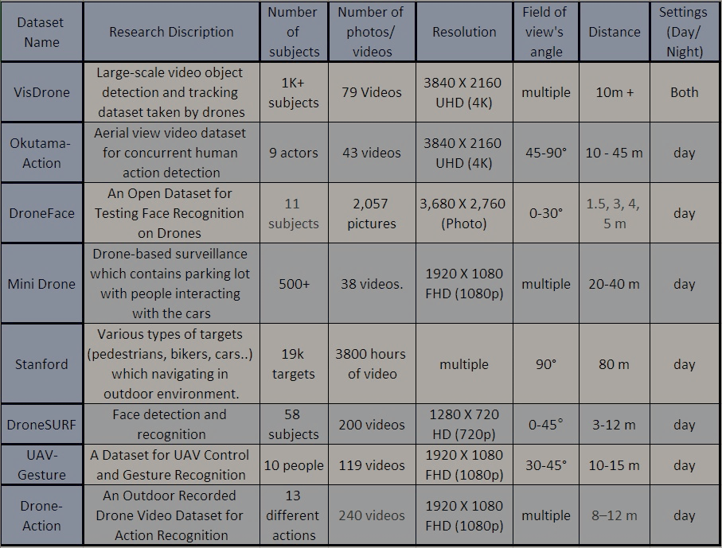
Literature review Summary :
Drones – Technology, uses, autonomous
Reaction identification
Researched and analyzed other datasets
Example
5

Slide 6

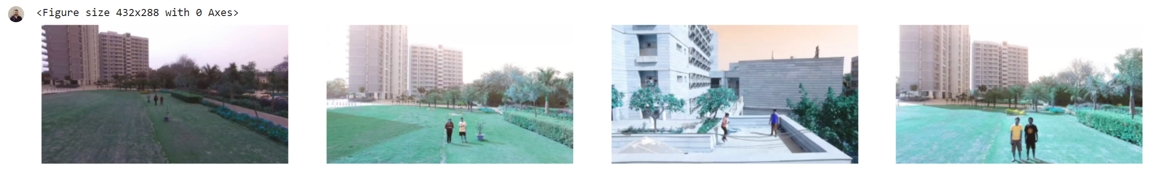
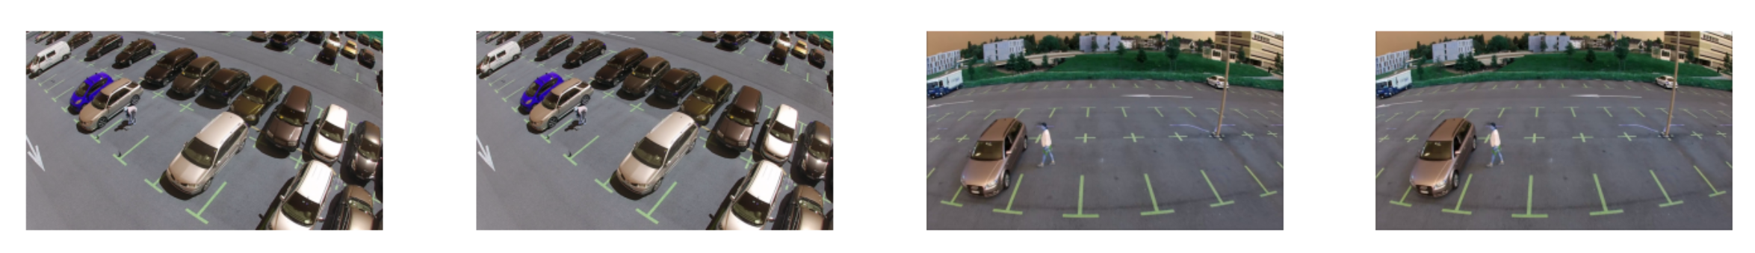
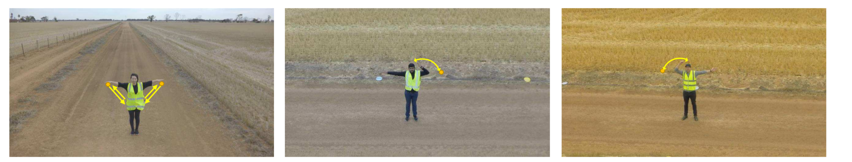
Other Drone Datasets example
“DroneSurf”
Our unique
Dataset!
“Mini Drone”
“UAV-Gesture”

Slide 7



Planning
Ethics approval
Drone flight training
Experiment method & protocol

Slide 8
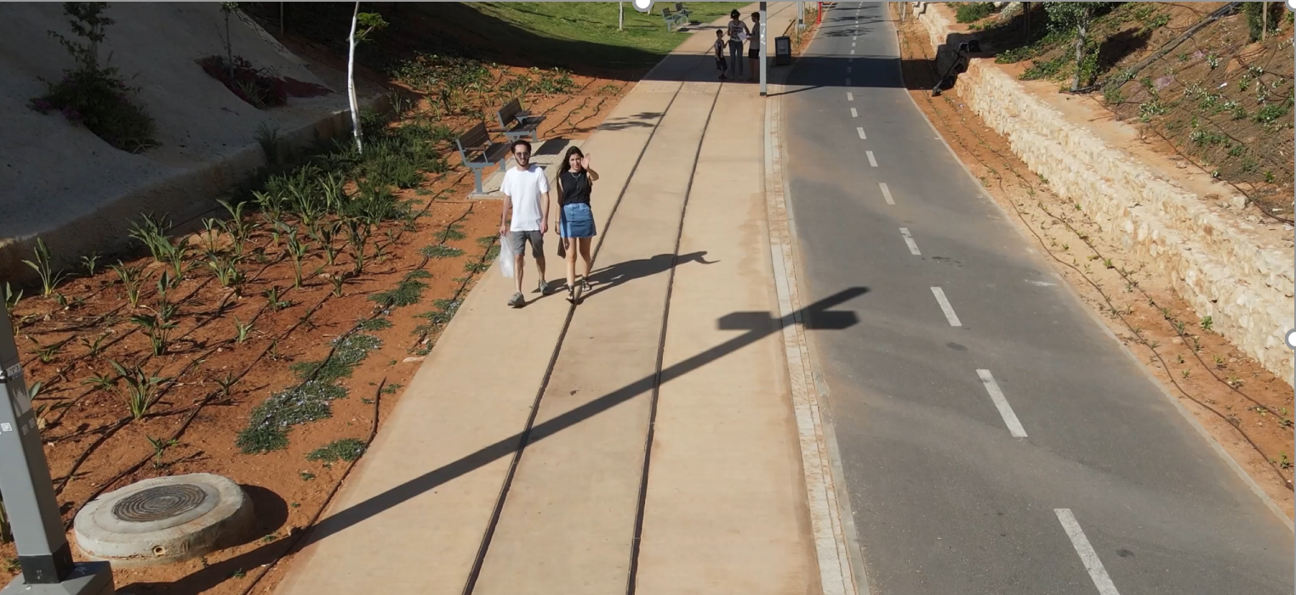

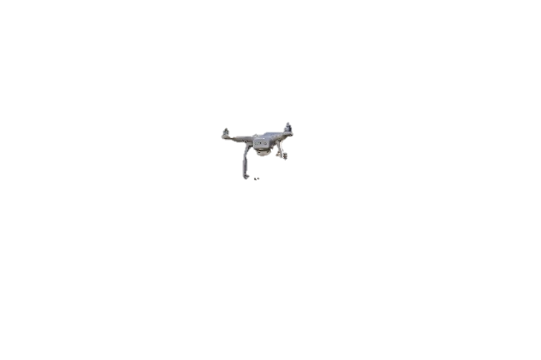

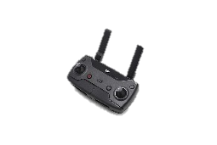



The Process
1. Video shooting

Slide 9
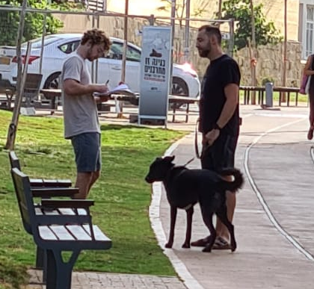
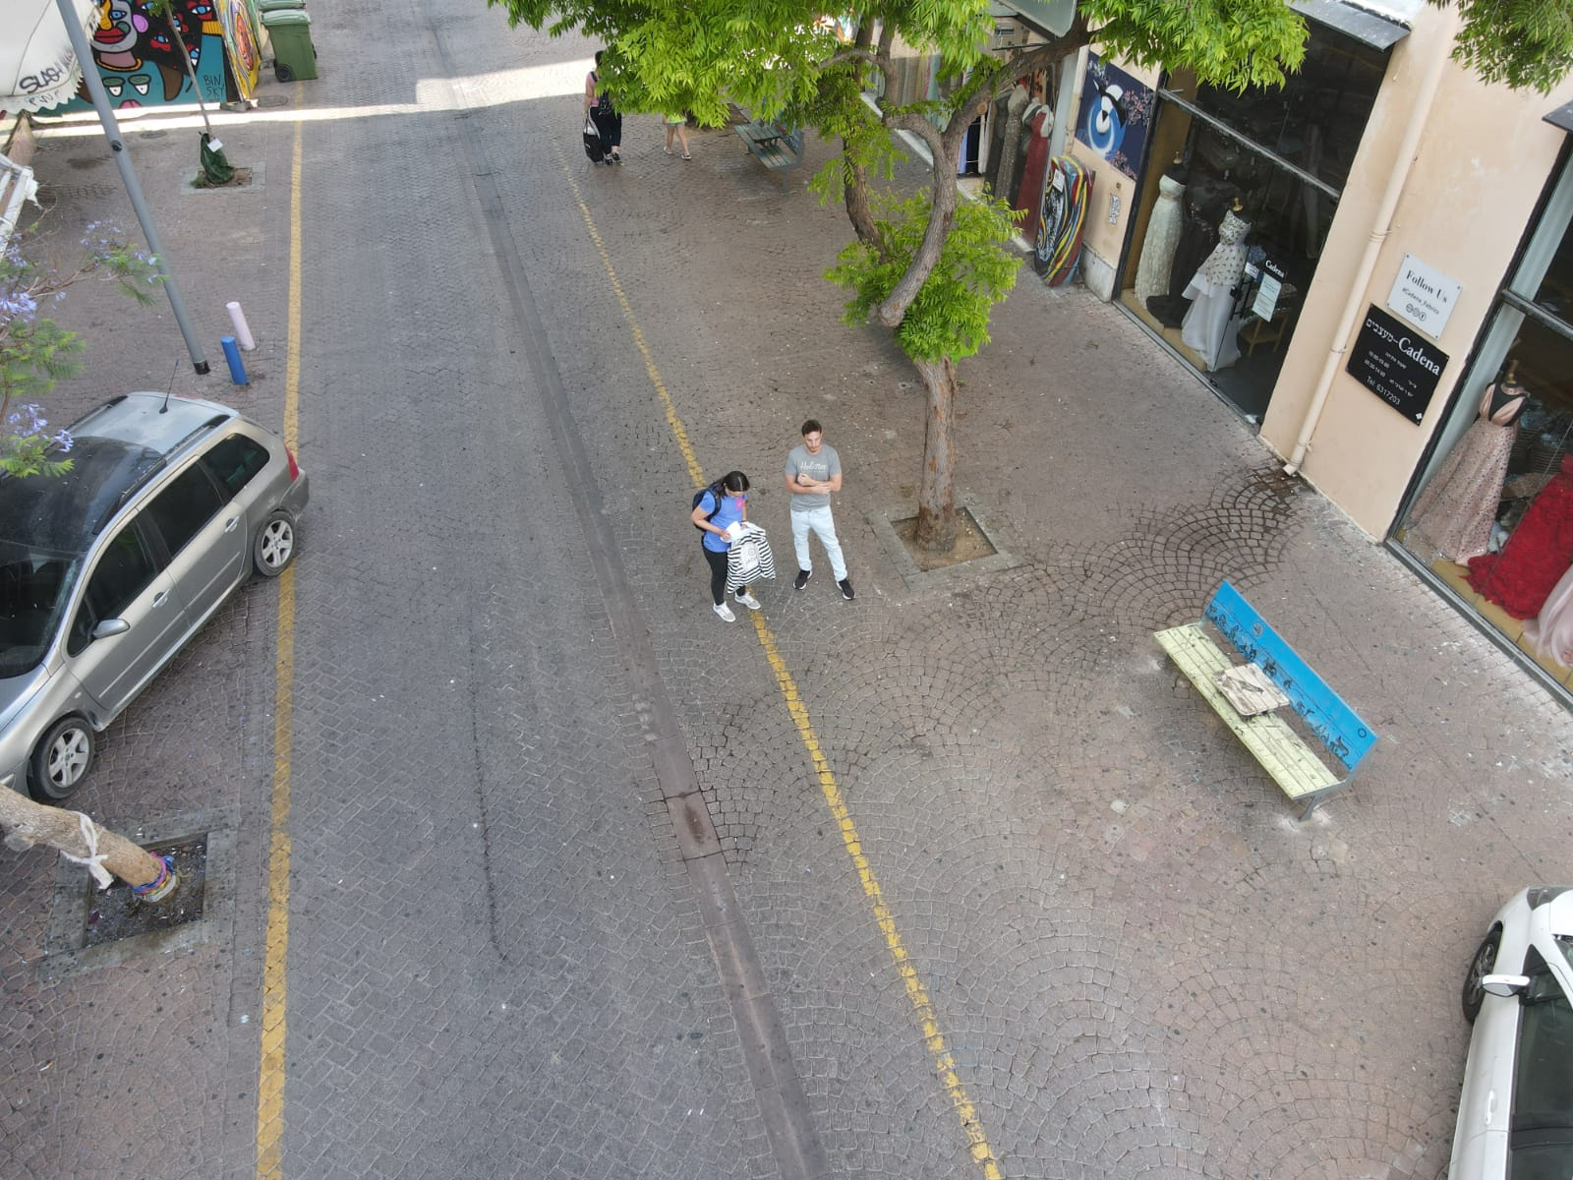
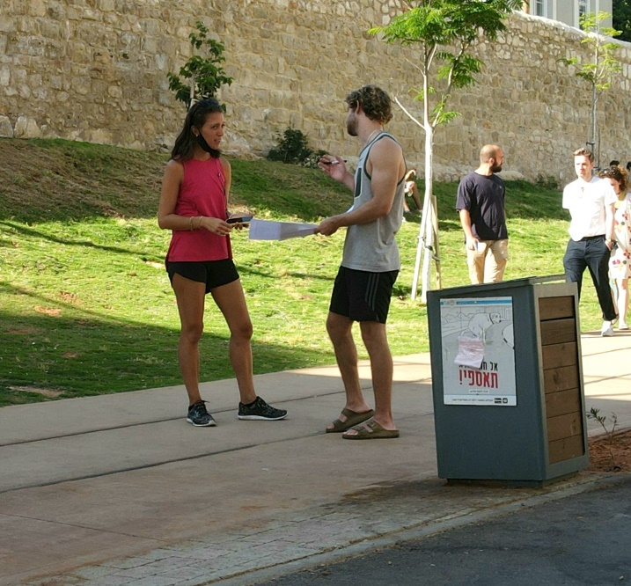
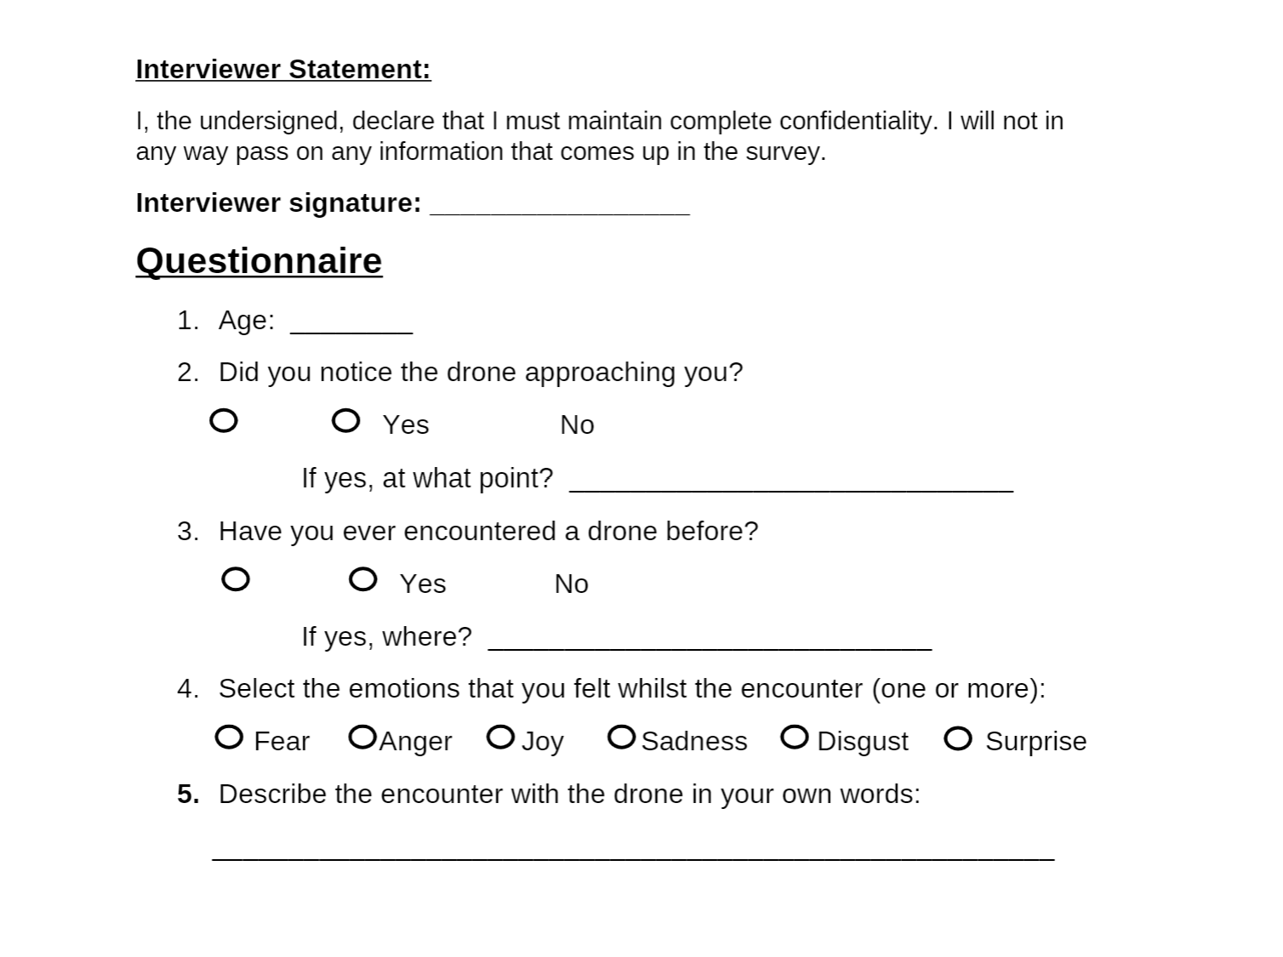
The process
2.Questioning the person

Slide 10
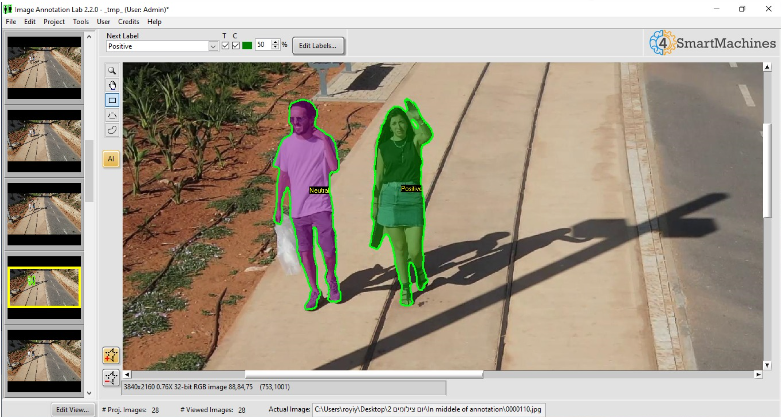
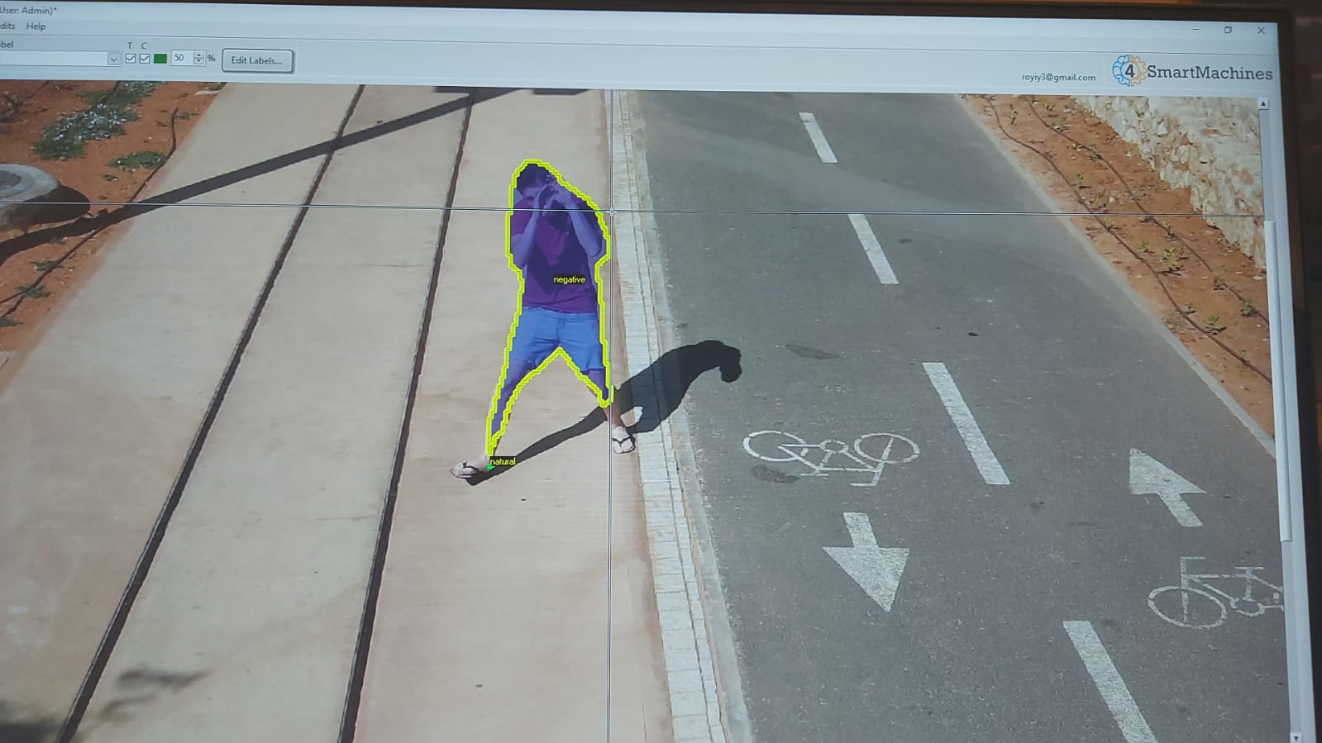
The process
3. Labeling
1. Edit Video
2. Video to Frames
3. Labeling
Positive/Negative/Neutral/Looking
Negative labelling
4. Extract video to JSON

Slide 11
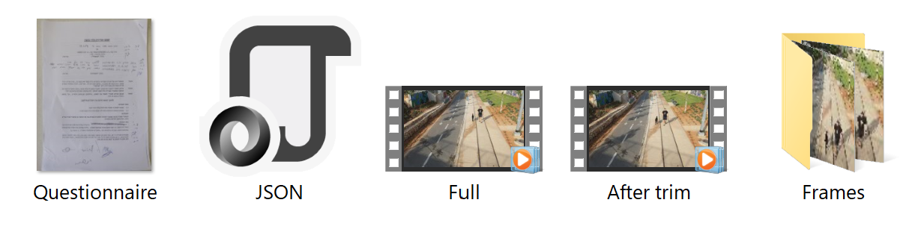
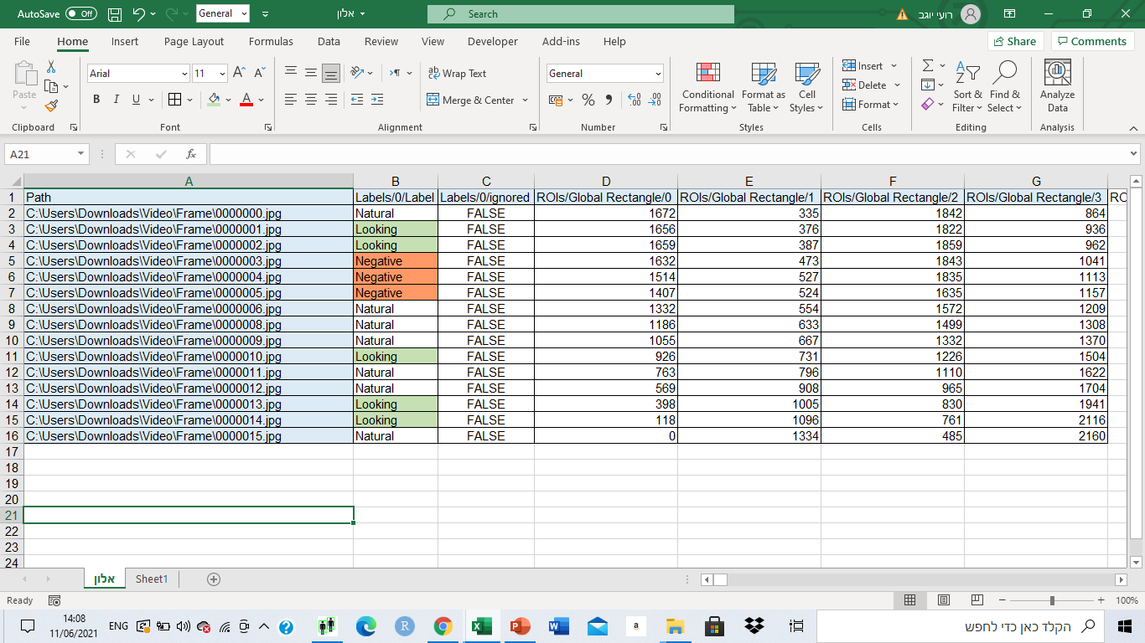
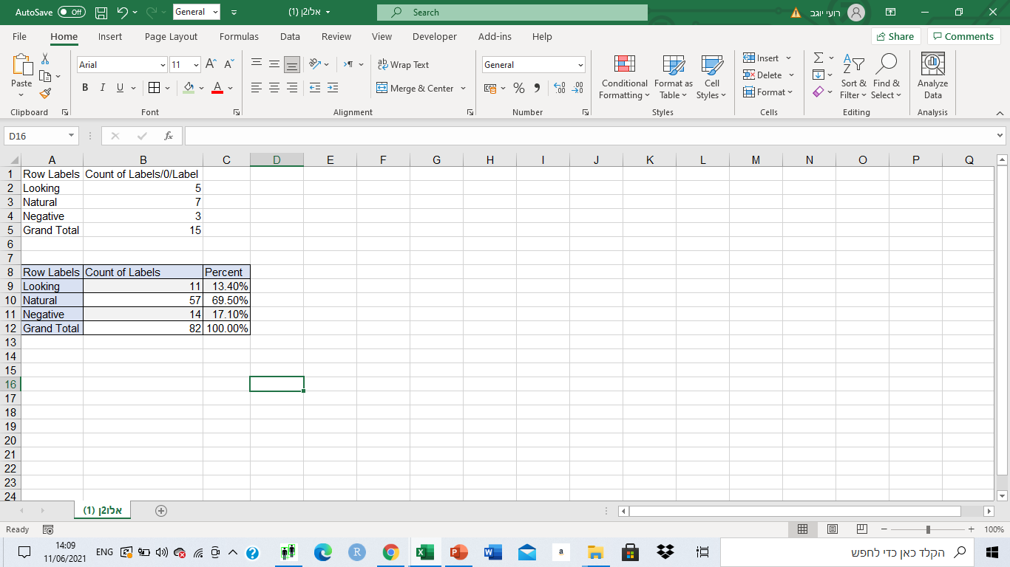
Results and outcomes
Sample
files:
11

Slide 12


The Numbers from the videos
67 Videos (out of 78)
7000+ Tagged frames
6 Shooting days

Slide 13

Distributions
48% male Vs. 52% female
71% Noticed the drone
94% have encountered a drone before

Slide 14

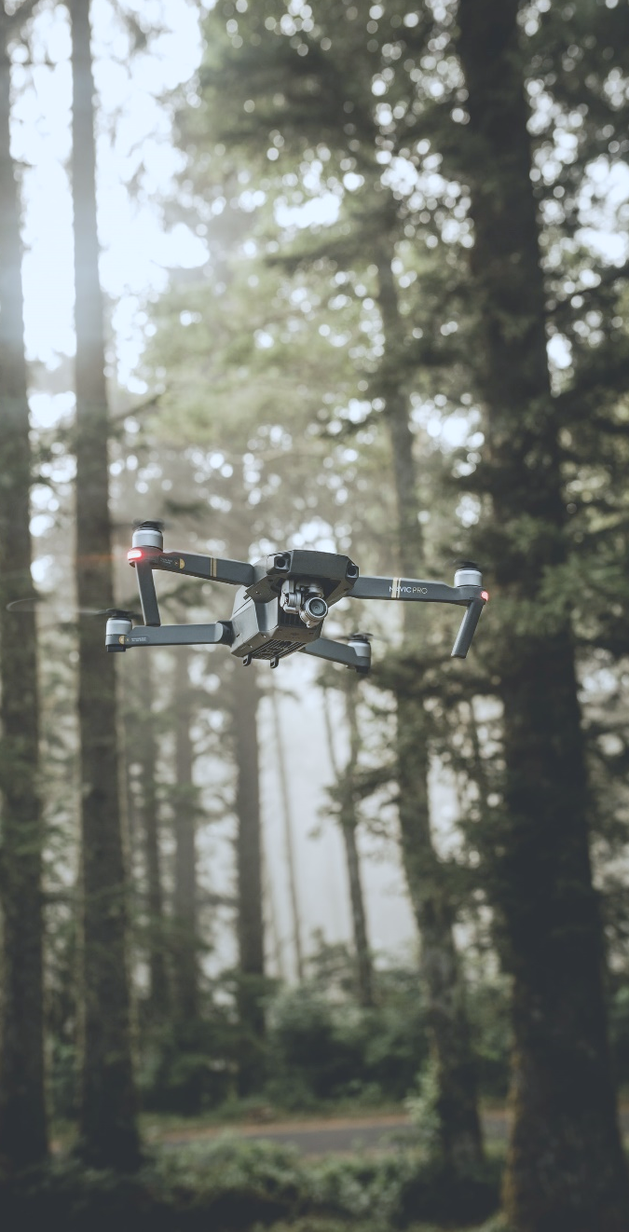
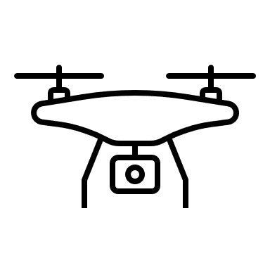


Analysis Conclusions
Cooperation of the participates
Short interaction
Lack of response

Slide 15

Summary
Dataset Was successfully created!
15

Slide 16

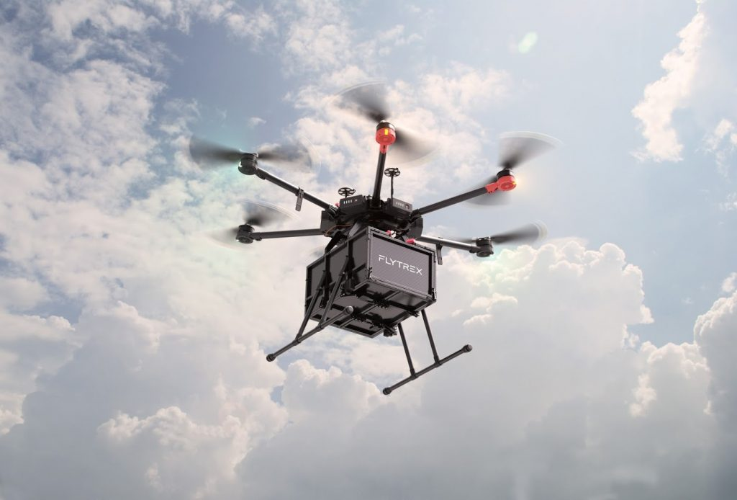
Thanks!
Jonathan Lahat
Alon Karmona
Roy Yogev
Questions?
16

